Slide 1
MCA Final Year Project (Review I) Detection Of Phishing Website Using Machine Learning
Submitted to the Presidency University, Bengaluru in partial fulfillment for the award of the degree of Master of Computer Applications(MCA)
Project Number : MCA_PR121
Under the supervision of
MS. Naiwrita Borah Asst. Prof.-SOIS School of Information Science
Name | Roll Number
Veeradimmu Madesh | 20232MCA0049

Slide 2
Content
Problem Statement
Literature Survey
Tools and Technologies to be used
Timeline of the Project
References

Slide 3
Problem Statement
Background :
Phishing has become a serious threat in the cyber world, wherein the hackers build false websites that are similar to the real websites with an aim to trick the users into revealing confidential information like login passwords, bank details, or personal data. These are human vulnerability attacks and frequently get around the conventional security features like firewalls or antivirus.
With advancing phishing methods, there is a growing necessity for more sophisticated and adaptive techniques for detecting and warding off these attacks. Machine learning, in its capacity for pattern analysis and data learning, presents a very viable method for the identification of phishing sites as different from non-phishing sites based on various characteristics.

Slide 4
Problem :
The rapid increase in phishing attacks poses a serious challenge to cybersecurity, as traditional rule-based detection methods (e.g., blacklisting, heuristic analysis) are often ineffective against new or sophisticated phishing websites. These methods struggle to keep up with the dynamic nature of phishing, where attackers frequently change domains, use obfuscation techniques, or employ social engineering tactics.
Additionally, manual identification of phishing websites is time-consuming and impractical given the scale of the internet. There is a critical need for an automated, accurate, and scalable solution to detect phishing websites in real-time, minimizing false positives (legitimate websites flagged as phishing) and false negatives (phishing websites missed by the system).

Slide 5
Objective :
The aim of this project is to design a machine learning system for the identification of phishing websites. The system must examine website features—URL composition, webpage content, domain data, and security flags—to label websites as phishing or legitimate. The solution should be able to achieve high accuracy, minimize detection time, and keep pace with the changing nature of phishing techniques through the use of machine learning algorithms.
Identifying the most relevant features (e.g., URL length, presence of HTTPS, number of redirects, domain age, presence of suspicious keywords) that effectively differentiate phishing websites from legitimate ones.
Obtaining a reliable and balanced dataset of phishing and legitimate websites for training and testing the machine learning model.

Slide 6
Literature Review
SI NO | Year | Authors | Title | Description | Methodology
1 | 2025 | Mowafaq Salem Alzboon | Phishing Website Detection Using Machine Learning | Explored ML techniques for phishing detection, focusing on URL and content features in a gamified context. | Random Forest, CNN
2 | 2024 | Singh & Kaur | Multilingual Phishing Detection System | Integrated a multilingual chatbot with ML to detect phishing websites and support user accessibility. | XGBoost, Natural Language Processing
3 | 2023 | Patel et al. | Feature Selection in Phishing Detection | Focused on selecting optimal features (URL, content, and external) to improve detection performance. | Random Forest, Feature Selection
4 | 2024 | Chen & Wang | Adversarial-Resilient Phishing Detection | Proposed a system to detect phishing websites while addressing adversarial attacks by training on adversarial examples. | Gradient Boosting, Adversarial Training

Slide 7
5 | 2023 | Nguyen & Tran | Phishing Detection Using Graph-Based Features | Introduced a graph-based approach to detect phishing by analyzing website link structures and domain relationships | Graph Neural Networks (GNN)
6 | 2023 | Li & Zhou | Lightweight Phishing Detection for IoT Devices | Developed a lightweight model for phishing detection on resource-constrained IoT devices using URL features. | Decision Trees, K-Nearest Neighbors (KNN)
7 | 2023 | Ahmed & Khan | Explainable AI for Phishing Detection | Proposed an explainable AI system to detect phishing websites and provide interpretable results to users. | Random Forest, SHAP (Explainability)
8 | 2024 | Gupta & Sharma | Real-Time Phishing Detection Using Edge Computing | Developed a system for real-time phishing detection by deploying ML models on edge devices for faster processing. | Random Forest, Edge Computing
9 | 2024 | Mishra & Bose | Phishing Detection with Visual Features | Incorporated visual features (e.g., website screenshots) alongside URL features to detect visually deceptive phishing sites. | CNN, Transfer Learning
10 | 2022 | Kumar & Sharma | Hybrid Model for Real-Time Phishing Detection | Developed a hybrid model combining ML and DL for real-time phishing detection using | XGBoost, Long Short-Term Memory (LSTM)

Slide 8
Module Design
Data Collection Module
Purpose : Collects phishing and legitimate URLs from sources like PhishTank and Alexa.
Output : Raw dataset (URLs and labels: 1 for phishing, 0 for legitimate).
Data Preprocessing Module
Purpose: Cleans data (removes duplicates, handles imbalance) and splits into training/testing sets.
Input: Raw dataset.
Output: Cleaned training and testing sets.
Feature Extraction Module
Purpose: Extracts features (e.g., URL length, HTTPS presence, subdomains, IP address, suspicious chars
Input: Cleaned dataset.
Output: Feature matrix

Slide 9
Model Training Module
Purpose: Trains a machine learning model (e.g., Random Forest) on the training set.
Input: Feature matrix (training set).
Output: Trained model.
Classification Module
Purpose: Classifies new URLs as phishing or legitimate using the trained model.
Input: New URL, trained model.
Output: Classification result (phishing/legitimate).
Evaluation Module
Purpose: Evaluates model performance on the test set using metrics like accuracy, precision, recall.
Input: Test set, trained model.
Output: Performance metrics.

Slide 10
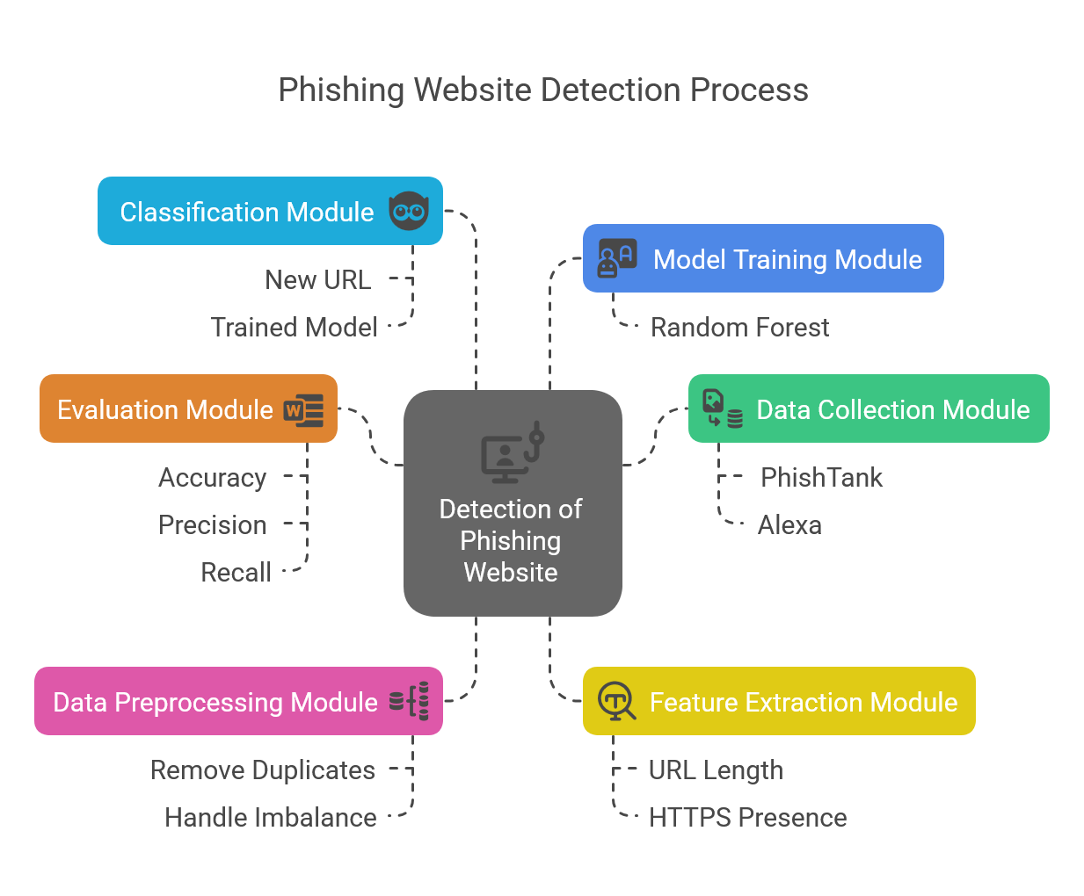

Slide 11
Tools And Technologies To Be Used
Development Tools: PyCharm, VS Code, Jupyter Notebook, Google Colab
Programming Languages: Python
Frameworks/Libraries: Scikit-learn, XGBoost, Pandas, NumPy, Matplotlib, Flask(Optional For UI)
Database: SQLite (for storing reference signatures)
Version Control: Git, GitHub
Additional Tools:SHAP (for explainable AI), Imbalanced-learn (for handling imbalanced datasets)

Slide 12
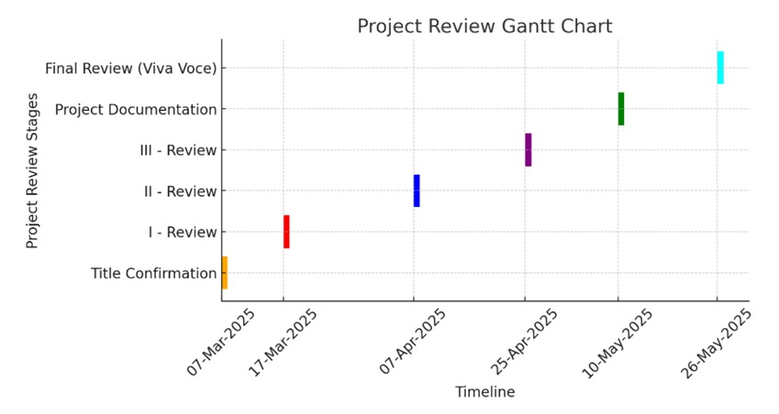
Timeline of the Project

Slide 13
References
Alzboon, M. S., et al. (2025). Phishing website detection using machine learning. Gamification and Augmented Reality
Chen, L., & Wang, H. (2024). Adversarial-resilient phishing detection. International Journal of Network Security
Gupta, R., & Sharma, A. (2024). Real-time phishing detection using edge computing. IEEE Transactions on Network and Service Management
Mishra, P., & Bose, S. (2024). Phishing detection with visual features. Pattern Recognition Letters
Singh, M., & Kaur, P. (2024). Multilingual phishing detection system. Journal of Human-Computer Interaction
Ahmed, S., & Khan, R. (2023). Explainable AI for phishing detection. Journal of Cybersecurity Research
Li, X., & Zhou, Y. (2023). Lightweight phishing detection for IoT devices. Journal of Internet of Things
Nguyen, T., & Tran, H. (2023). Phishing detection using graph-based features. IEEE Access
Patel, R., et al. (2023). Feature selection in phishing detection. Journal of Machine Learning Research
PhishTank. (2023). PhishTank: A collaborative project to track phishing sites. Retrieved from https://www.phishtank.com/

Slide 14


